Slide 1
The hyperboloid model

Slide 2
Do you have any associations when hearing „hyperboloid“?

Slide 3
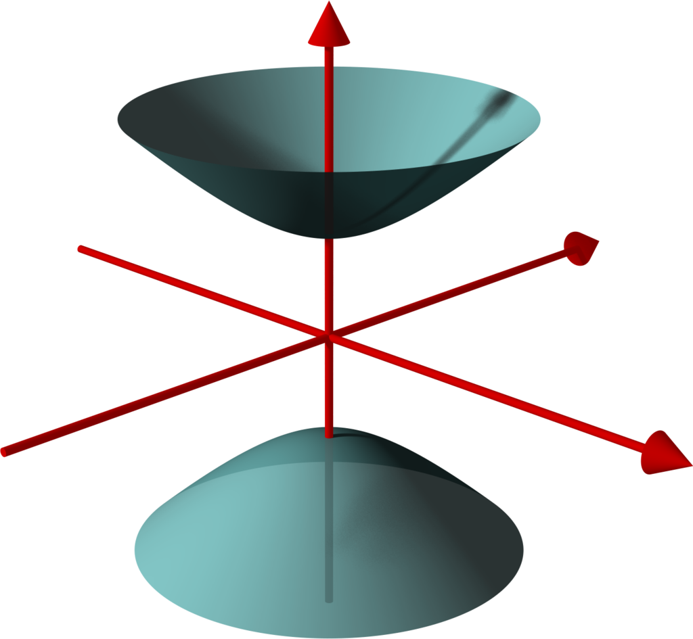
General overview
We want a model from which we can derive geodesics, the line element, angles etc in hyperbolic geometry
We‘re taking a look at a sphere in R³, and we‘re defining a model in which the radius of the sphere is -1. We set this model in Minkowski space.
We‘re calling the pseudosphere we‘re getting a hyperboloid
We can generalize the hyperboloid to every dimension, but for now we‘ll be looking at a hyperboloid in Minkowski space R^{(2,1)}

Slide 4


Hyperboloid
Definition of our Hyperboloid:

Slide 5

Riemannian metric
The inner product of Minkowski space is
Proposition:
We can take the inner product reduced to the hyperboloid as the Riemannian Metric for our hyperboloid
Our metric needs to be positive definite, so that we obtain genuine distances,
because we measure the length

Slide 6
Riemannian metric
The metric is positive definite on our hyperboloid
General fact:
For a space V with signature (p,q) and a subspace W with signature (p1,q1), the orthogonal to the subspace W has signature (p-p1,q-q1)
Minkowsi space has signature (2,1).
The subspace created by v has signature (0,1) per definition of H, and since Minkowski space only has one negative dimension, its orthogonal can‘t have any.

Slide 7
Line element
The Riemannian metric is thus positive definite on the tangent plane to a vector v of the Hyperboloid.
Therefore, the line element is simply the inner product of Minkowski space restricted to our Hyperboloid.
ds² = dx² + dy² – dt²

Slide 8
isometries
The group of linear Isometries on Minkowski space is O(2,1), the Lorentz group.
Proposition: This is also the group of Isometries of our Hyperboloid.
Proof: Isometries are distance preserving per definition.
because the line element of H is simply the line element of Minkowski space restricted to the hyperboloid.

Slide 9





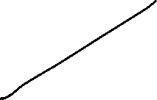




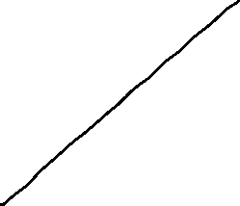
curvature
We have constant negative curvature of -1 per definition of our hyperboloid
In Opposition to a sphere in R³, where we have a constant curvature of 1.
In general, if we widen our look upon hyperboloids with other Radius R, the curvature changes and becomes -1/R².

Slide 10
geodesics, distance
Proposition:
The geodesics on the hyperboloid are the intersections of it with planes through the origin.
Proof:
General fact:
The fixed points of an isometry are geodesics.
A reflection through a plane is an isometry as long as it contains the origin.
When looking at the reflection through a plane, the fixed points are the intersections of the plane with the hyperboloid.

Slide 11
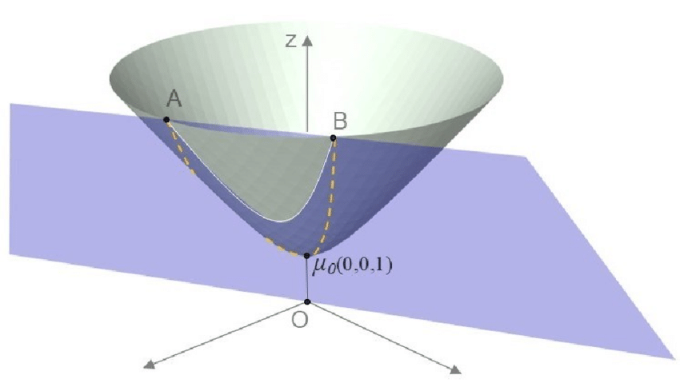

Slide 12
Geodesics, distance
The geodesics form hyperbolas.
These hyperbolas are name giving for hyperbolic geometry.
The distance between two points A and B is defined as the infimum of all the curves between A and B.
Since the shortest curve is per definition the geodesic, the distance between A and B can be measured by calculating the length of the curve that results when we intersect the plane through A,B and the origin with H. A plane is defined by 3 points, therefore the geodesic is unique.
!! The length has to be calculated with the line element of our hyperboloid, not the euclidean line element !!

Slide 13
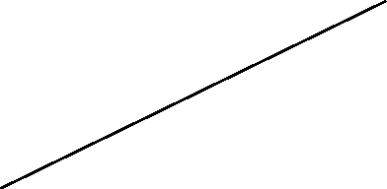


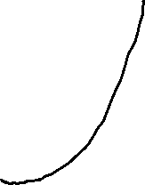


Slide 14



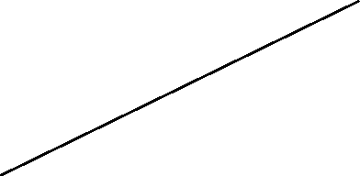
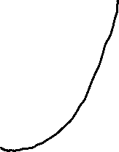



Slide 15







Slide 16
Geodesics, Angles
A parametrization of the geodesic can be written down explicitly.
The following shows a parametrization of with initial velocity v.
Proof:

Slide 17




Angles, Hyperbolic trigonometry
We can see that the hyperbolic angle can be calculated by
Proof:
Use parametrization of hyperbola
trigonometric pythagoras
addition theorem for hyperbolic cosine
Comparison:
Definition of hyperbolic angles we‘ve seen before:

Slide 18
Outlook on more Hyperbolic trigonometry
With the hyperboloid model and the information we‘ve gathered up to now, we can show laws such as for example the hyperbolic law of cosines for any hyperbolic triangle ABC
cosh c = cosh a cosh b – sinh a sinh b cos C

Slide 19
sources
Loustau, Chap. 5,13,14
Springborn, Chap. 4
Lee2020

Slide 20
Thank you for you attention☺

